Slide 1
Plano ISD Cattle Exhibitor Meeting
March 07th 2019
6:00 p.m.
McMillen High School
Rm. F111

Slide 2
Welcome
Please sign in with name phone number and email

Slide 3
Steers and heifers
Market/Breeding Animal
Initial Cost starting at $3000 and going up
Feed runs $15 per bag

Slide 4
Cluster Cattle Chairpersons
Cattle Committee is sub-committee of each chapters Livestock Committee
First year appointments
Person from each Plano ISD FFA Chapter with most cattle exhibition experience
Plano East: Brent Love
Plano : Tiffany Wilson
Plano West: John Graf

Slide 5
Cattle Cluster Chairpersons
Duties Include but not limited to:
Reminding cattle students from your FFA chapter about meetings, barn clean-up schedule, show practices, livestock show information, loading/arrival times, veterinary information and other general information.
Duties Do Not Include Disciplinary Actions

Slide 6
Weekly Update
Beginning tomorrow, March 8th, you will begin receiving a weekly update via e-mail.
You can expect these on Monday’s but occasionally there will be weekly supplements on other days of the week.
Check each week, don’t just assume there is no new information for the week.
Documentation that you were informed.

Slide 7
Information
Weekly E-mail
Chapter Websites
www.pesh.ffanow.org
www.plano.ffanow.org
www.planowest.ffanow.org
G-mail Account: Barn Clean-up calendar can be shared.

Slide 8
Rats/Rodents
PISD does provide limited pest control
Limited applications due to school facility
Clean Areas!
Remove Manure in Morning and Afternoon
Empty Wheelbarrow after each use
Install Rat Traps in Tack Areas
Do Not Feed Cats!
These cats are current on all vaccinations, but need to stay aggressive. Do not pet; Do not feed!

Slide 9
Birds
Netting

Slide 10
Rats/Rodent

Slide 11
Flies
Fly Traps and Fly Tape

Slide 12
Cleaning Schedule/Duties
Barn Clean-up Schedule will be released as soon as all stalls are assigned.
2 people assigned to barn clean-up each week
Duties include cleaning both barns
Excluding this first week, barn clean-up schedule will run Monday-Sunday
Teacher will check on Monday Mornings
Expect correspondence if not completed to teacher specifications.

Slide 13
Cleaning Schedule/Duties
Both Barns Thoroughly Swept
Clean-up any manure
Roll up blower hoses
Roll up water hoses
Make sure cooling area is clean
Fans turned off, misters turned off at end of the day
Make sure washrack is clean
Make sure water in turnout is full!
Make sure wheelbarrows are outside stacked against barn 3 (Main Cattle Barn)
Don’t assume that the automatic system is working!

Slide 14
Drains
Should be cleaned during assigned barn cleanup

Slide 15
Wash Area
Should be cleaned after each use

Slide 16
Manure Disposal
Please put manure as far into the dump area as possible.

Slide 17
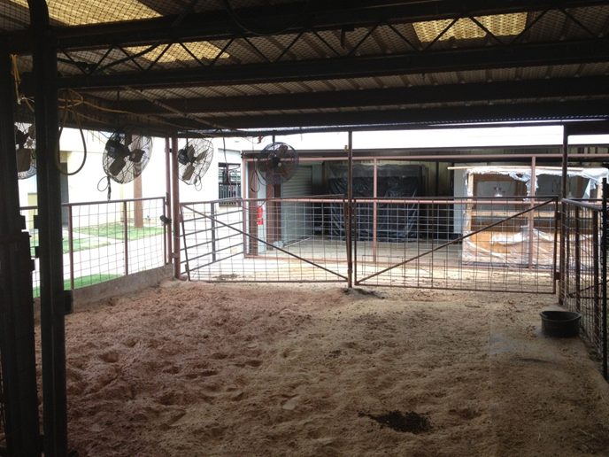
Cool Area
Should be used as much as possible!!!!!!!!

Slide 18
Work Days / Show Practices
Monthly at the bare minimum

Slide 19
Schedule
June: Steer Validation, Prosper
North Texas State Fair Steer Show, Denton
Heart of Texas Fair, Waco
Friends and Family of Plano FFA, McKinney
Lewisville FFA Winter Buckle, Denton
Princeton FFA Holiday Classic
January: Collin County Livestock Show
Fort Worth Livestock Show
Houston Livestock Show
San Antonio Livestock Show

Slide 20
Summer Schedule
At least one jackpot per month
Dates will be available as soon as we get them

Slide 21
Family Atmosphere

Slide 22
Sand
Each pen will receive sand
Additional sand may be brought in upon your request/as needed or may be brought in a wheelbarrow at a time by you.

Slide 23
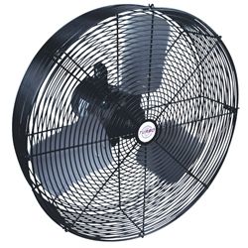
Fans/Misters
Should be on at all times
Misters should be on if temp rises above 72 degrees other wise they should be off.

Slide 24
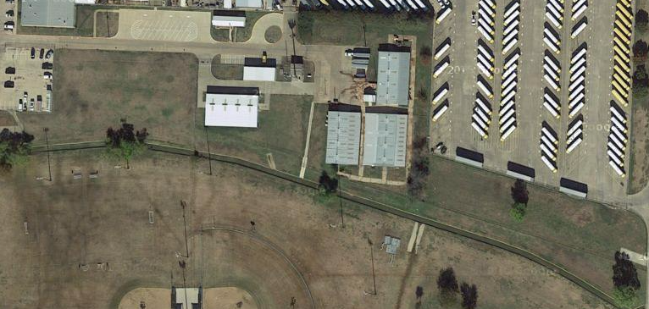
Turnout: Pasture and Trap

Slide 25
Attending other shows
Can attend whatever show you would like but must haul your own animals.
Ag Teachers must be aware of the show at least 2 weeks ahead of time. No Exceptions

Slide 26
De-worming
Once per month

Slide 27
Feed Ration
Will be determined by your Ag teacher, the breeder, as well as the student

Slide 28
Veterinarian
All Veterinary cost are the responsibility of the student and their family. We will advise as needs arise.

Slide 29
Curfew 10:30 p.m.
No Exceptions!!!

Slide 30
Hay
Will be purchased by the students as well.
Is essential for good digestive health of the animal.

Slide 31
T-shirts!
Will be designed and worn by students and teachers to all shows upon arrival to the show.

Slide 32
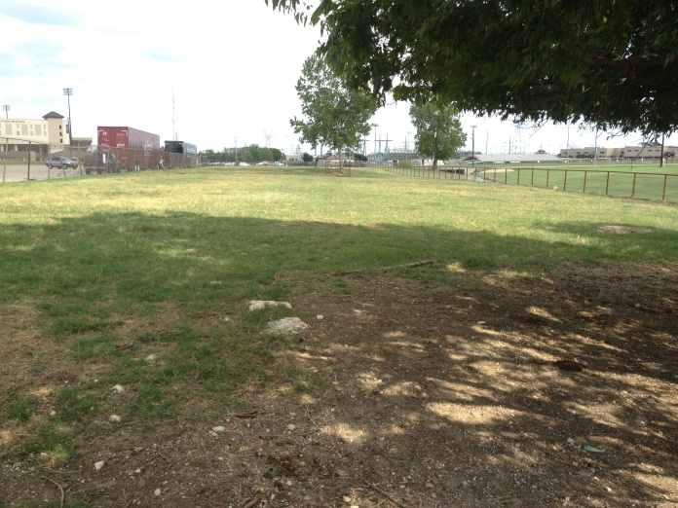
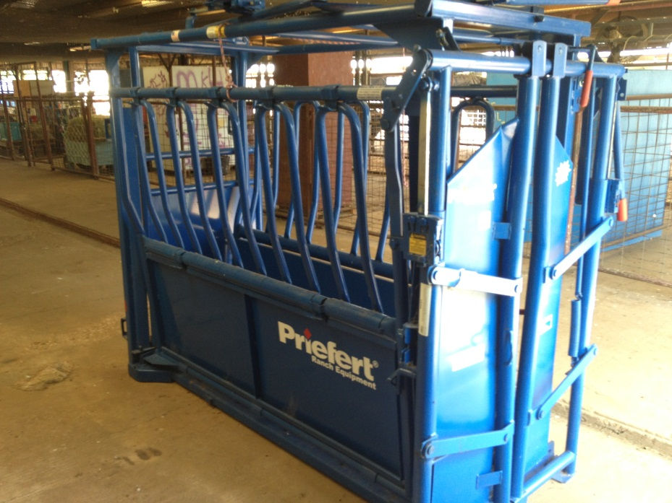
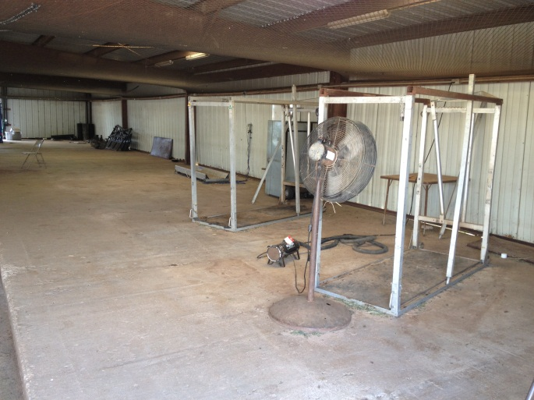
Cattle Barn

Slide 33
